Slide 1
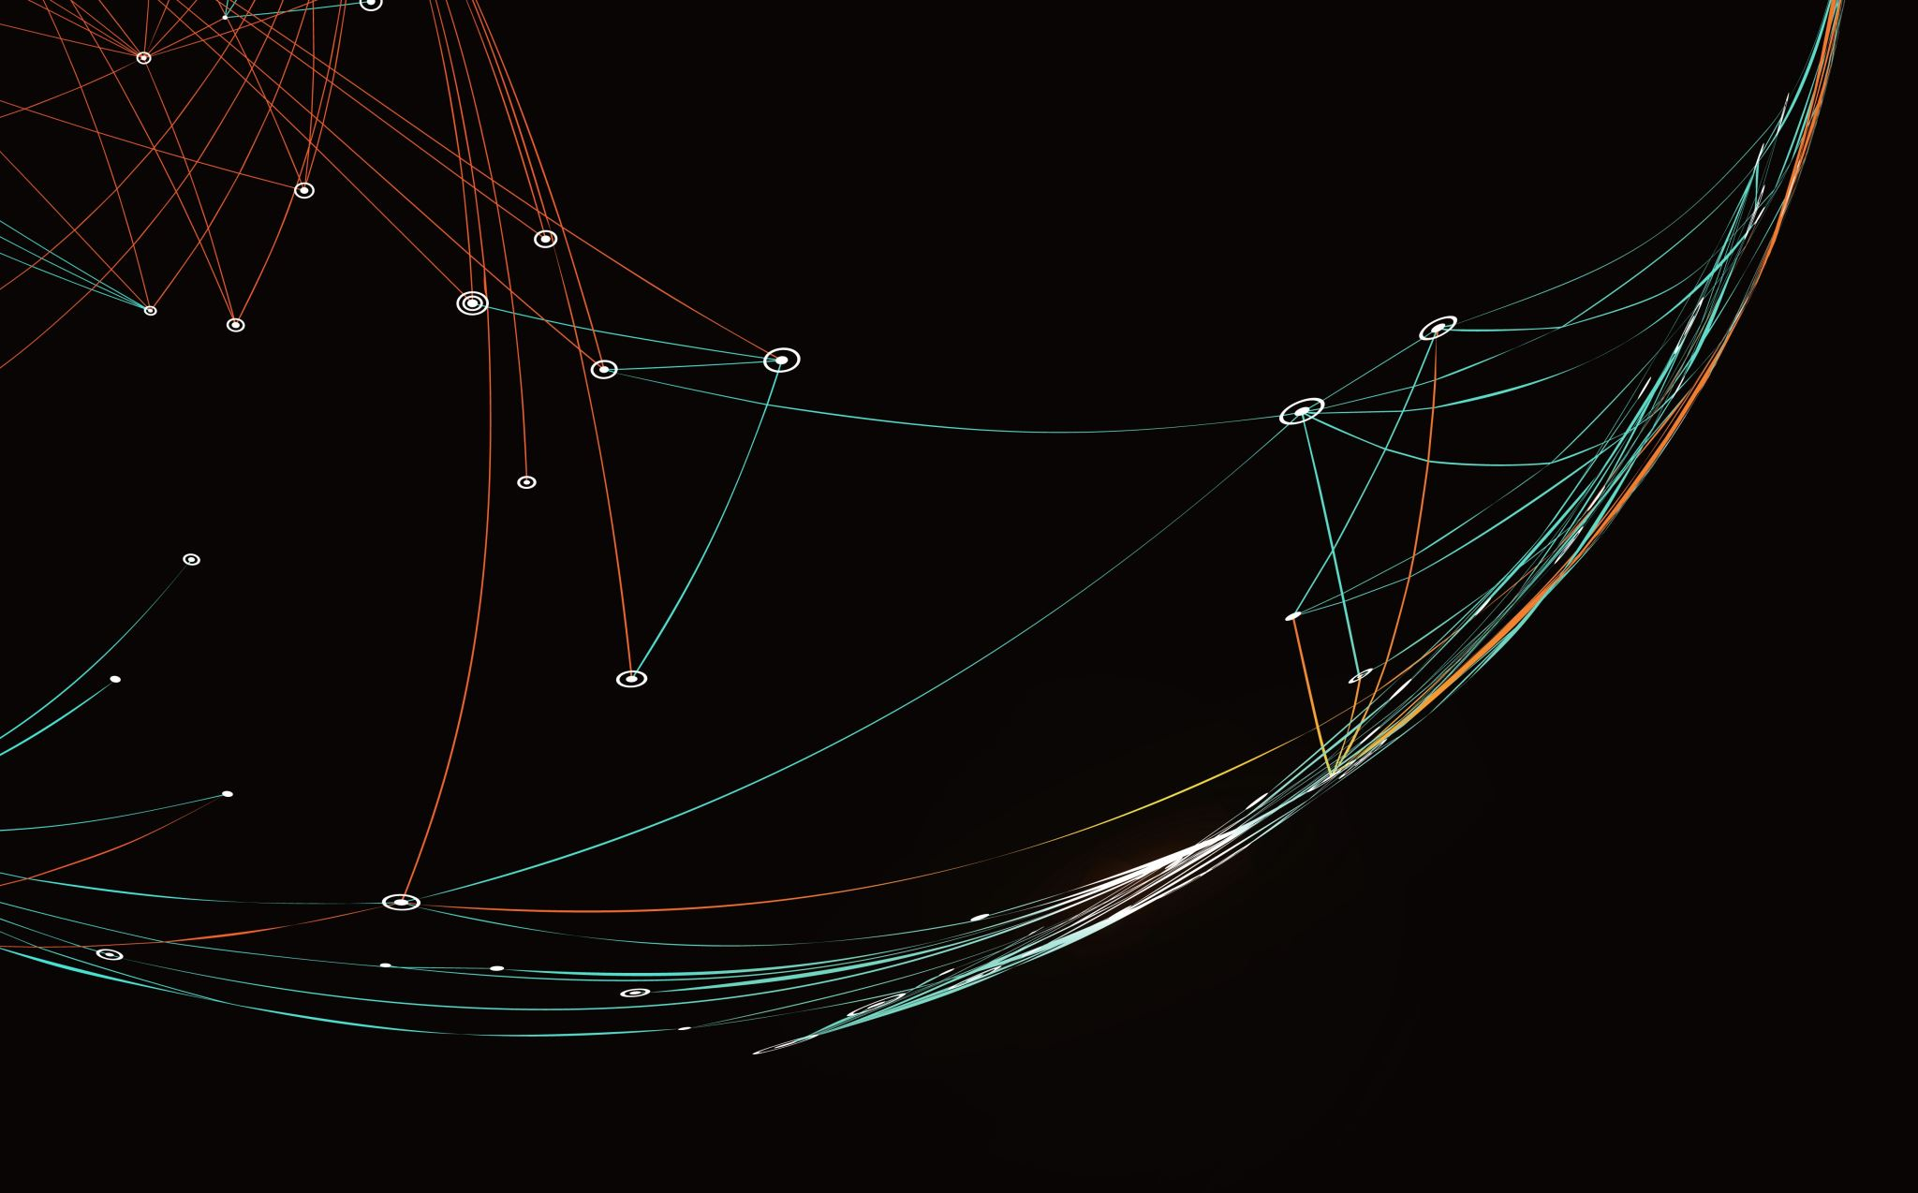
Automatic attendance system
Submitted By:
Shraddha Khadepatil (100820094)
Varun Kadian (100820124)
Geethu Kannan(100801786)
Yash Halani (100848564)

Slide 2
Business Problem
The manual attendance system has some drawbacks:
Risk of Human error
Time-consuming
Ineffective and outdated
Keyboard and printing errors

Slide 3
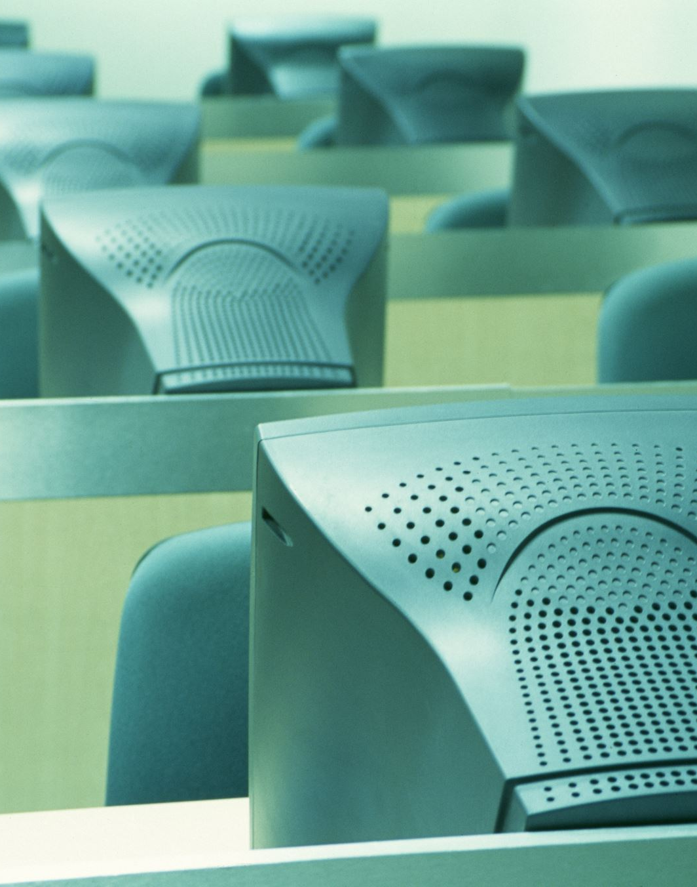
Solution
We propose an automatic attendance system
Instructors can keep track of attendance.
More efficient and convenient way than manually taking attendance in the classroom.
Uses face recognition technology to recognize a person's features and automatically indicate attendance, which is far faster than the old method.

Slide 4
Technologies to be used
Model development using python
Libraries used: openCV, dlib

Slide 5
Workflow
Create Dataset
Train and test data split
Create the model
Train the model
Recognize the face
Mark the attendance

Slide 6
Conclusion
The facial recognition feature is secure and reliable
Available for use
Saves a lot of time
Handle a huge number of inputs
Error free

Slide 7

Thank You

